Slide 1

Internship PERIOD
JAN 04 – JUN 30
Presented by:
Keerthika s

Slide 2
AGENDA
SOFT SKILLS
LEARNING
PROJECT
TECHNICAL SKILLS
TEAM & SELF LEARNING
SUBDOMAIN TAKEOVER
HEAPDUMP ANALYZER

Slide 3

SOFT SKILL

Slide 4

SOFT SKILL
PRESENTATION SKILLS & DESIGN
BUILDING OUR BRAND
CAMPUS TO CORPORATE
PROBLEM SOLVING
CLEAR WRITING & EDITING
TIME MANAGEMENT
ADVANCED GRAMMER
LEADERSHIP SKILLS
BUSINESS WRITING
FINAL INTERN PRESENTATION – CYBER CRIME CAUSES, IMPACTS AND PREVENTION

Slide 5
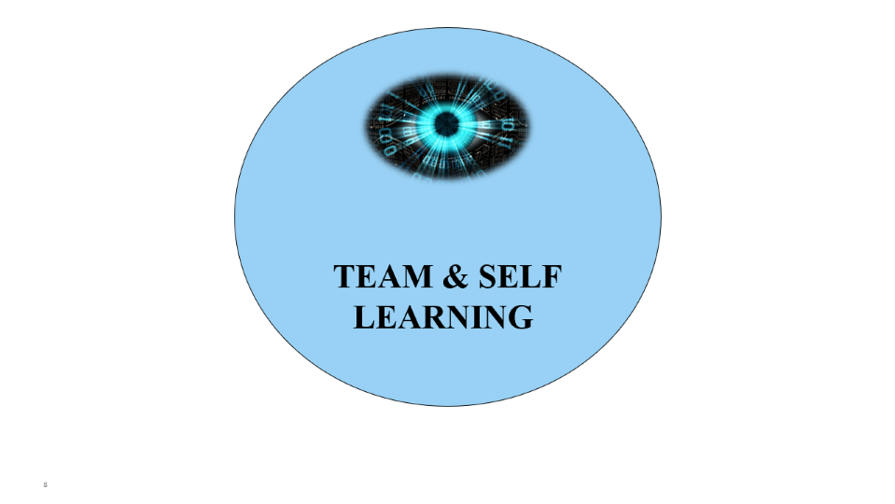
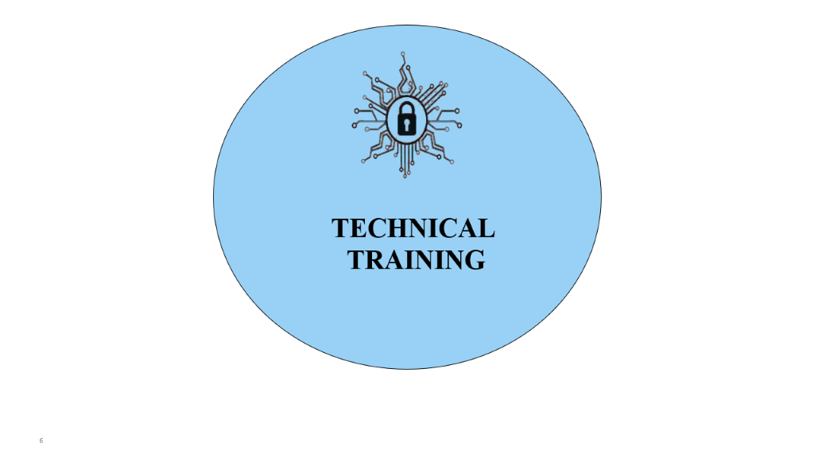
LEARNING

Slide 6

TECHNICAL
training

Slide 7

TECHNICAL
training
CYBER SECURITY DEFINITION, NIST FRAMEWORK
CIA TRAIDS
KILL CHAIN
OSI LAYER & BASIC NETWORK
ATTACKS
OWASP TOP 10
DATA AND ENDPOINT SECURITY
CASE STUDY PRESENTATION – BANGLADESH BANK CYBER-HEIST

Slide 8

TEAM & SELF
learning

Slide 9
Team & self
learning
BASICS OF CYBER SECURITY & TYPES
ACCESS CONTROL
EXPLORE OWASP TOP 10 IN TRYHACKME
WEB FUNDAMENTALS
CTF
SUBDOMAIN TAKEOVER
HEAPDUMP

Slide 10
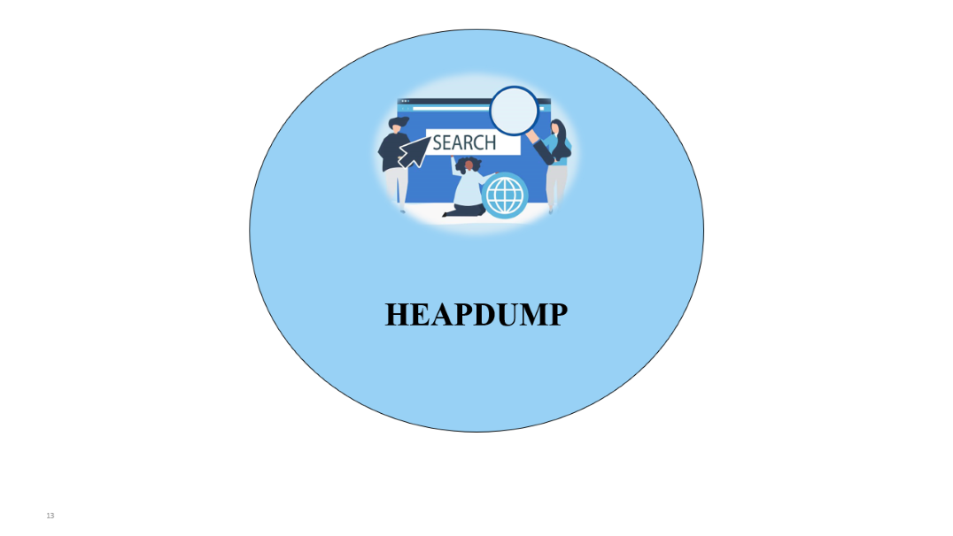
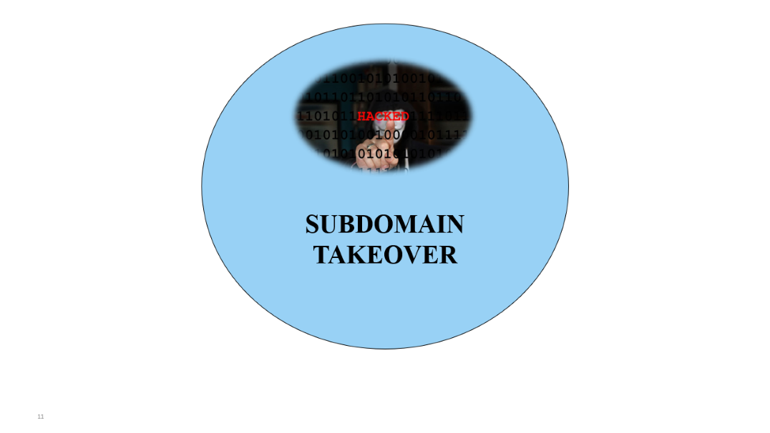
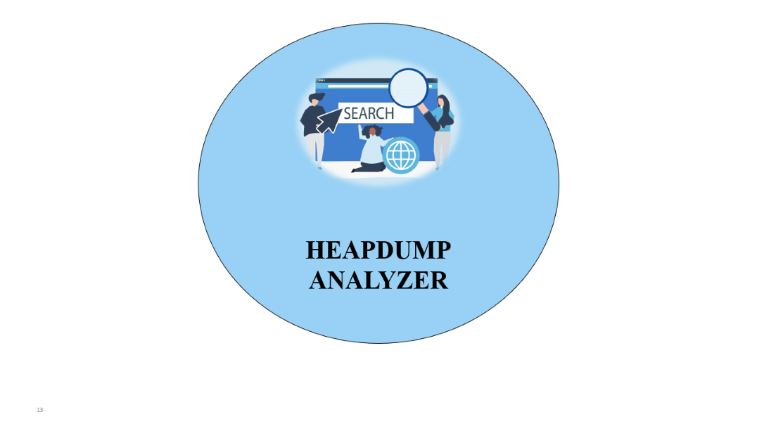
PROJECT

Slide 11

SUBDOMAIN
TAKEOVER

Slide 12
SUBDOMAIN TAKEOVER
DOMAIN CREATION
S3 BUCKETS
DNS RECORD
FETCHING OF SUBDOMAIN
SEARCHING FOR VULNERABILITY(RESPONSE BASED )
ZOHO MAIL & LINKING TO DOMAIN
FETCHING EMAIL FOR THE VULNERABLE SUBDOMAIN
SEND MAIL TO DOMAIN HOLDER

Slide 13

HEAPDUMP
ANALYZER

Slide 14
HEAPDUMP
ANALYZER
ANALYSIS OF HEAPDUMP FILE
COLLECTING SENSITIVE DATA
FRONT END TO UPLOAD HEAPDUMP FILE FROM USER
USER WILL SELECT SENSTIVE PREFERNCES
PASSWORD , CIENT_ID, BEARER, API CREDENTIALS, AWS CREDENTIALS
TO MINIMIZE THE SEARCHING TIME

Slide 15

THANK YOU

